Slide 1
21AIE302
Advanced Computer Networks
Final Project Presentation

Slide 2
Team Members
CB.EN.U4AIE20004 AMEEN ASHADULLAH M
CB.EN.U4AIE20017 GHAYATHRI DEVI K
CB.EN.U4AIE20019 GORANTLA V N S L Vishnu Vardhan
CB.EN.U4AIE20039 Menta Sai Aashish
CB.EN.U4AIE20062 Sai Aravind V

Slide 3
LOAD BALANCING WITH RYU CONTROLLER

Slide 4
PREVIOUS STUDIES ON THIS TOPIC
One study proposed a load balancing algorithm called "Round Robin with Least Connection" that combines the traditional round-robin algorithm with the least-connection algorithm to improve the performance of load balancing in Ryu-based SDN networks. The proposed algorithm was evaluated using a testbed of OpenFlow-enabled switches and the results showed that it outperforms the traditional round-robin algorithm in terms of average response time and throughput.
Another study proposed a load balancing algorithm based on the genetic algorithm for use with the Ryu controller in data center networks. The proposed algorithm was evaluated using a simulation environment and the results showed that it can effectively balance the traffic among servers and improve the overall performance of the network.
A third study proposed a load balancing algorithm for use with the Ryu controller in cloud networks. The proposed algorithm uses a combination of the least-connection and shortest-queue algorithms to balance the traffic and improve the performance of the network. The algorithm was evaluated using a simulation environment and the results showed that it can effectively balance the traffic and improve the performance of the network in comparison to the traditional round-robin algorithm.

Slide 5
APPLICATIONS
Data Center Networks
Internet Service Providers (ISPs)
Cloud Networks
Software Defined WAN
Enterprise Networks

Slide 6
FAT TREE TOPOLOGY
A fat tree topology is a type of hierarchical network topology that is commonly used in data center networks. It is a type of Clos network topology, that uses multiple layers of switches to connect a large number of devices.
One of the main advantages of the fat tree topology is its scalability. The multiple layers of switches allow for a large number of devices to be connected to the network..

Slide 7
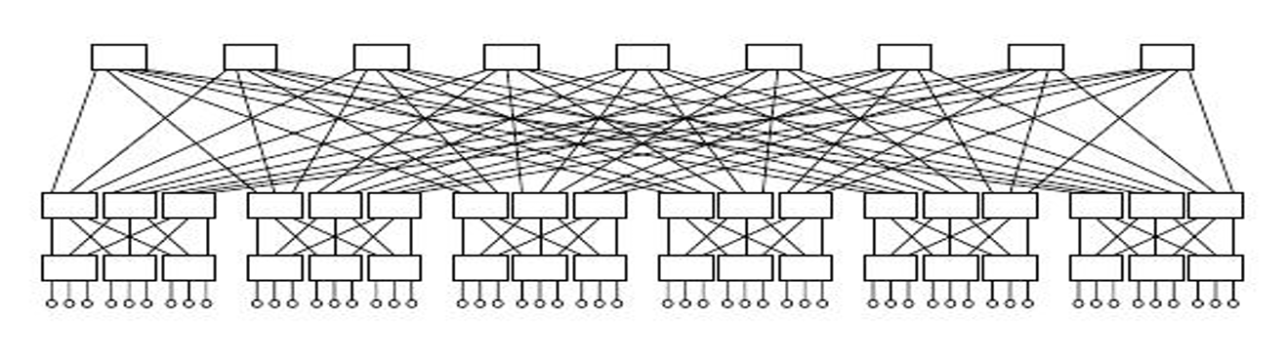
GENERAL FAT TREE

Slide 8
Number of pods = k
Number of servers in each pod = (k/2)^2
Number of Aggregation Switches = (k/2)
Number of Edge Switches = (k/2)
Number of Core Switches = (k/2)^2

Slide 9
LOAD BALANCING
Load balancing is a technique used to distribute workloads or network traffic across multiple servers, devices, or resources to ensure that no single server or device is overwhelmed by too many requests or connections.
Load balancing can improve the scalability, reliability, and performance of a system by distributing the workloads or traffic across multiple servers or devices, instead of relying on a single server or device to handle all of the traffic.

Slide 10
Stateless load balancing
A stateless architecture or application is a type of Internet protocol where the state of the previous transactions is neither stored nor referenced in subsequent transactions.
Each request sent between the sender and receiver can be interpreted and does not need earlier requests for its execution.
This is a protocol where a client and server request and response are made in a current state.

Slide 11
Stateful load balancing
Stateful architecture or application describes a structure that allows users to store, record, and return to already established information and processes over the internet.
It entails transactions that are performed using past transactions as a reference point. In stateful applications, the current transaction can be affected by the previous ones.
Because of this, a stateful application uses the same server to process its requests. Stateful transactions can be likened to an ongoing discussion with statements made based on already established facts.

Slide 12
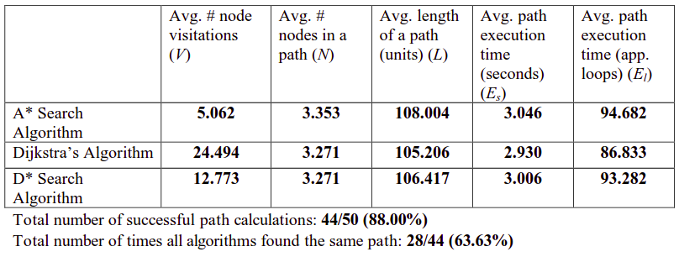
ANALYSIS OF PATH FINDING ALGORITHMS

Slide 13
DIJKSTRA’S ALGORITHM
This algorithm is used to calculate and find the shortest path between nodes using the weights given in a graph. (In a network, the weights are given by link-state packets and contain information such as the health of the routers, traffic costs, etc.).
Dijkstra’s algorithm keeps track of the currently known distance from the source node to the rest of the nodes and dynamically updates these values if a shorter path is found
Shortest Path Routing Algorithm

Slide 14
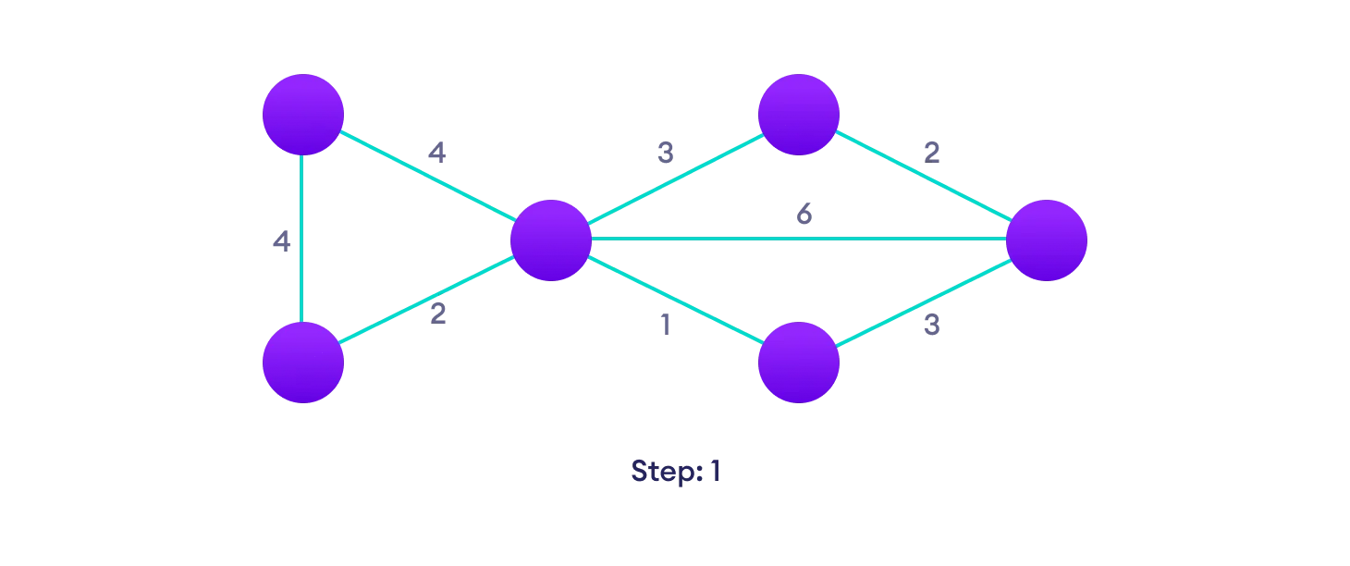
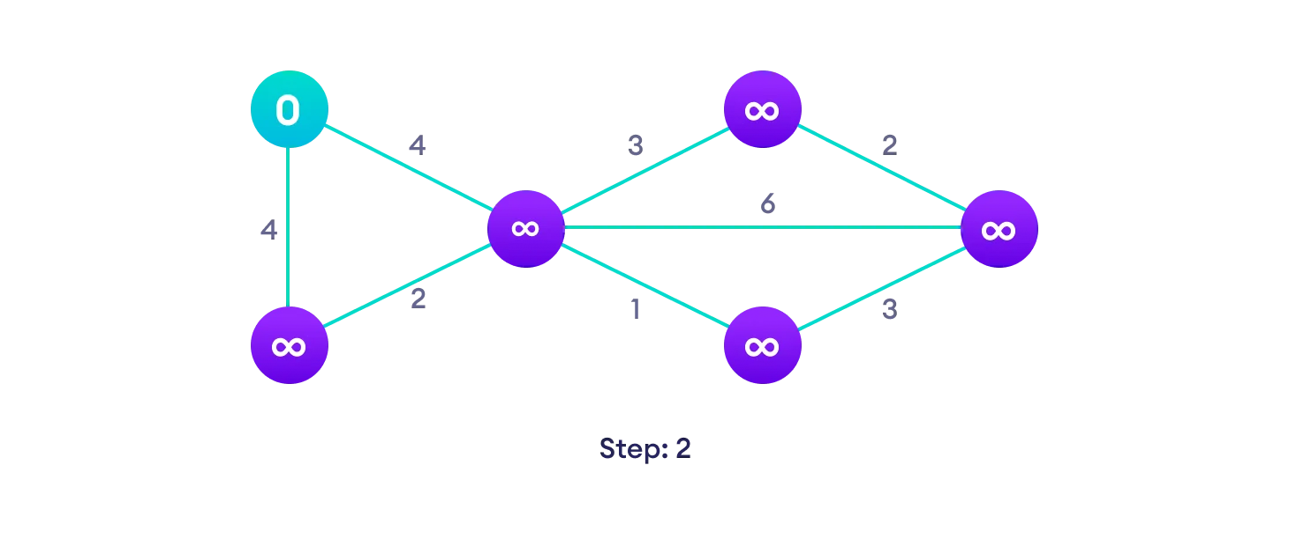
How Dijkstra’s Algorithm Works:

Slide 15
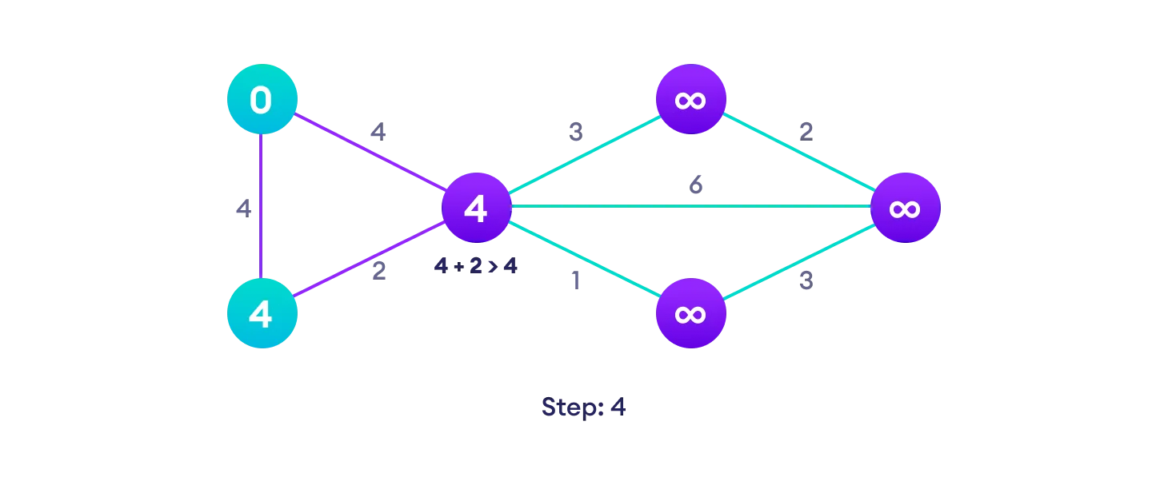
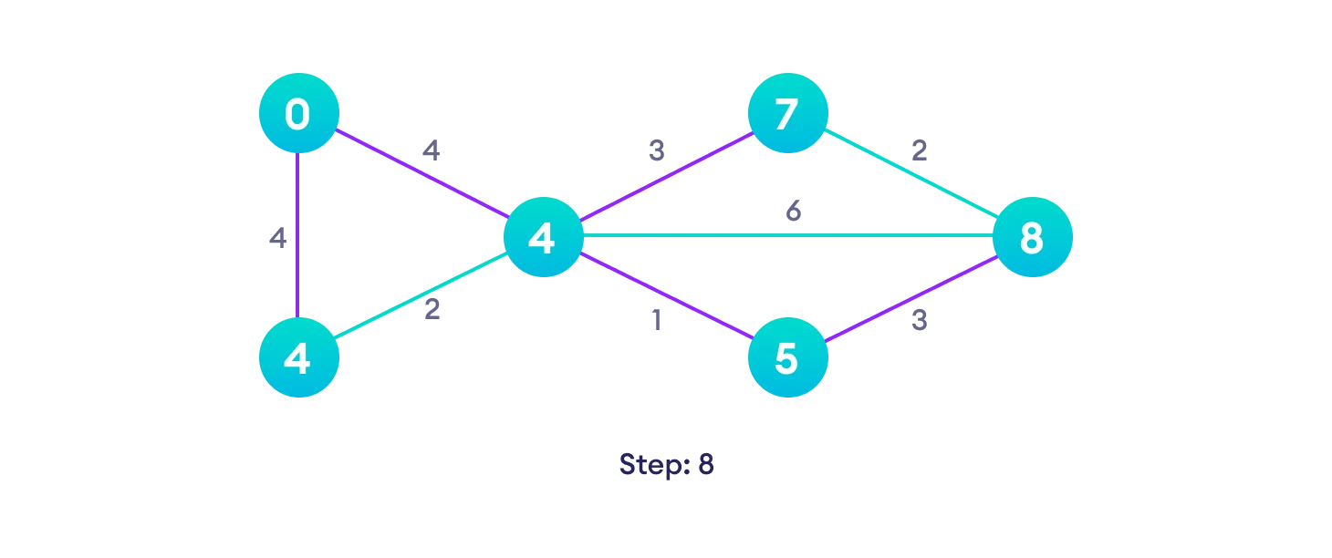

Slide 16

RESULTS & ANALYSIS

Slide 17
Multipath Routing with Load Balancing

Slide 18
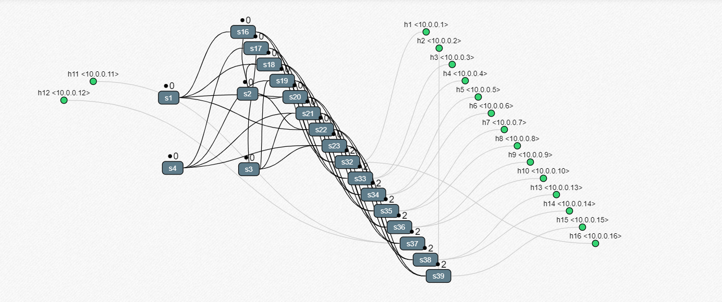
FAT TREE TOPOLOGY
Visualize the topology here

Slide 19
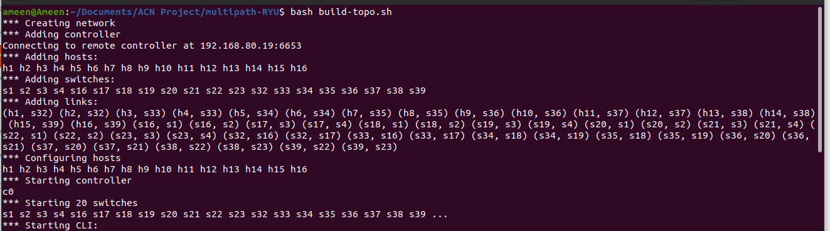
EXECUTION OF TOPOLOGY

Slide 20
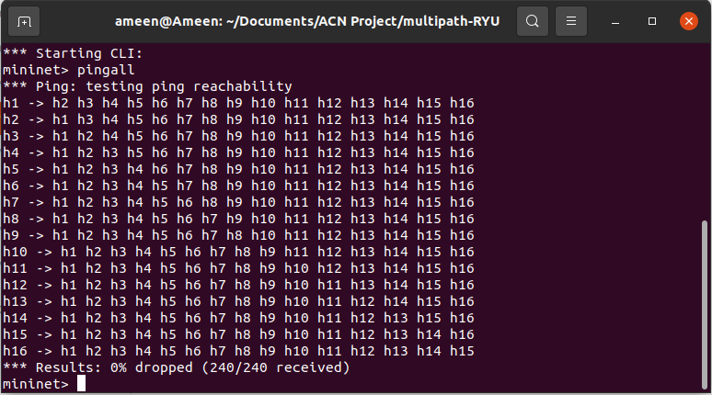
Successfully pinged each hosts

Slide 21
HARDWARE IMPLEMENTATION

Slide 22
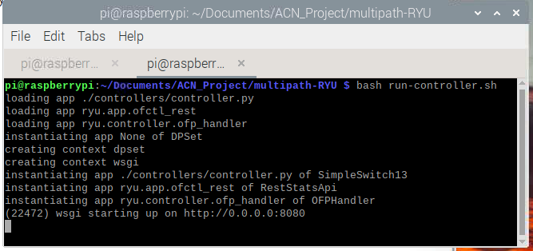
Running Custom Controller in Raspberry Pi:

Slide 23
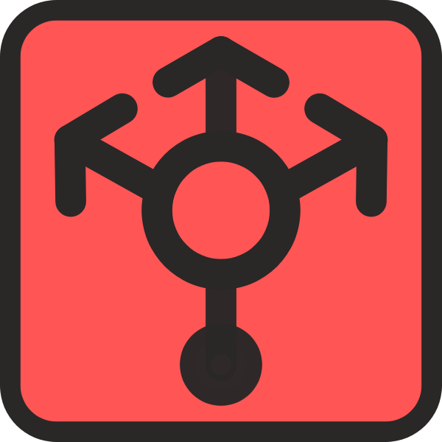
Check if packets are load-balanced between the two paths

Slide 24
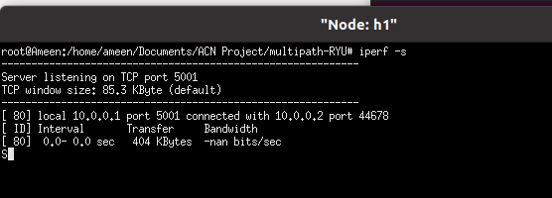
Setting ‘h1’ as server

Slide 25
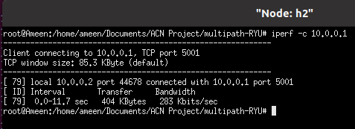
Setting ‘h2’ as client

Slide 26
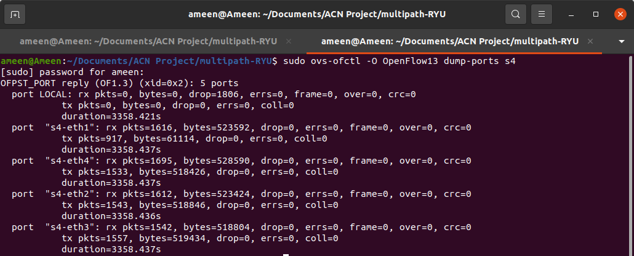
Check the total packets sent from the outgoing ports of s4

Slide 27
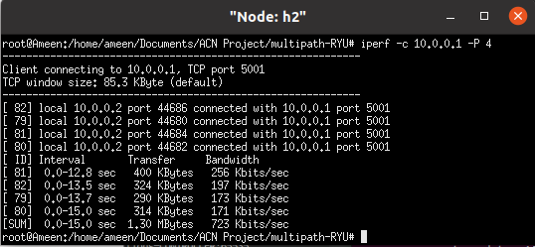
Add the number of parallel clients created at h2

Slide 28
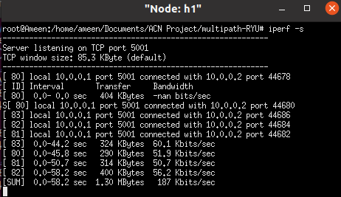

Slide 29
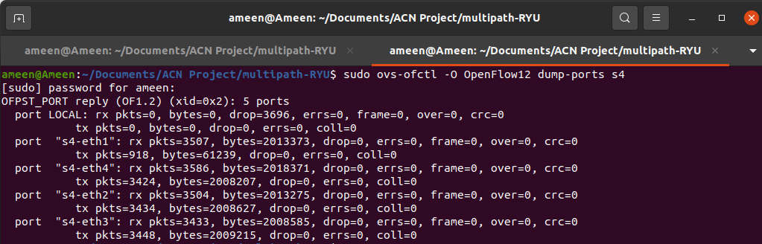
Check the total packets sent from the outgoing ports of s4

Slide 30
STATELESS LOAD BALANCING

Slide 31
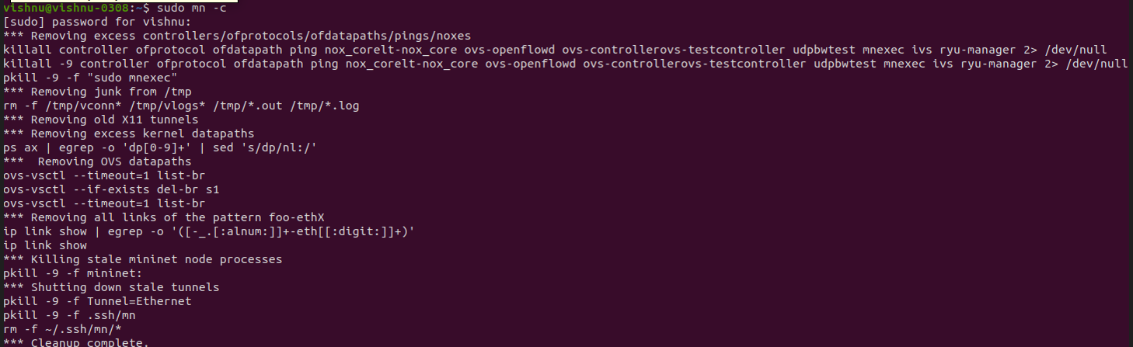

Slide 32
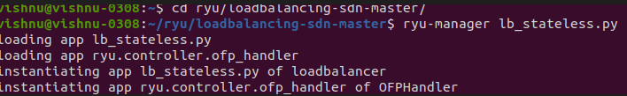
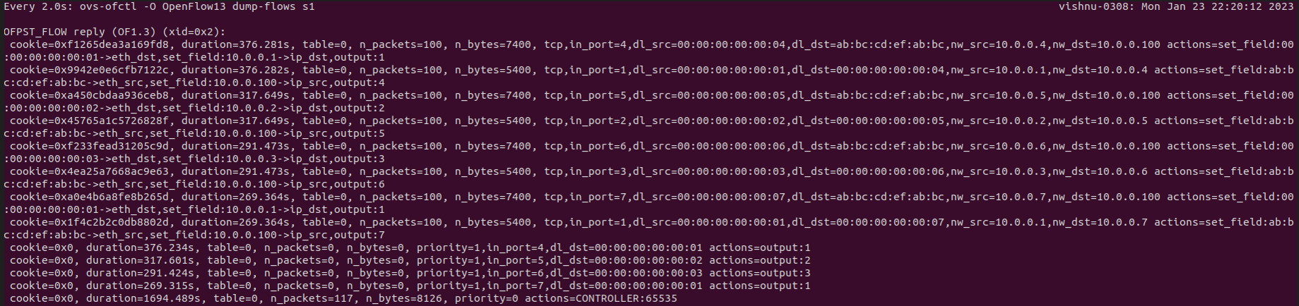

Slide 33
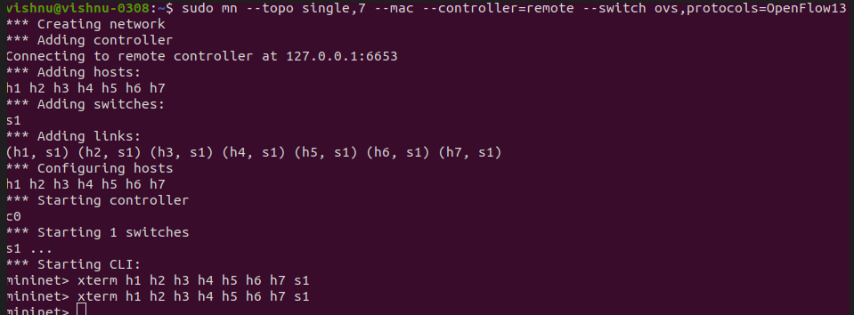

Slide 34
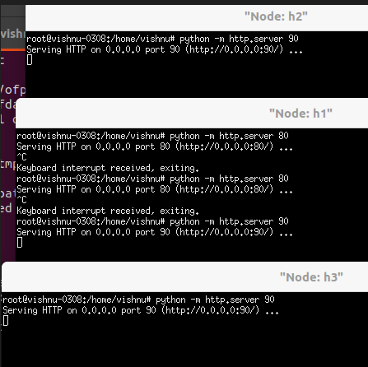

Slide 35
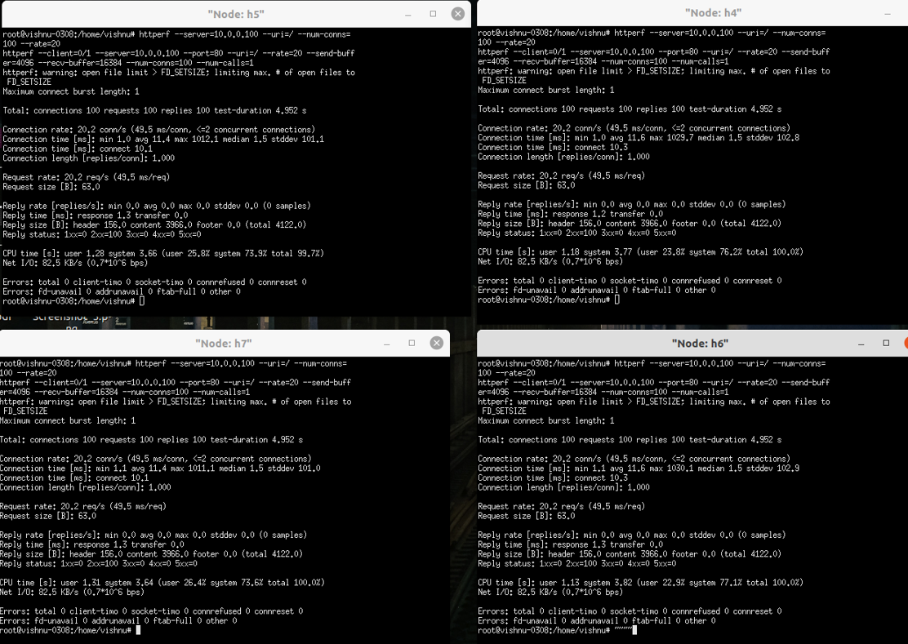

Slide 36
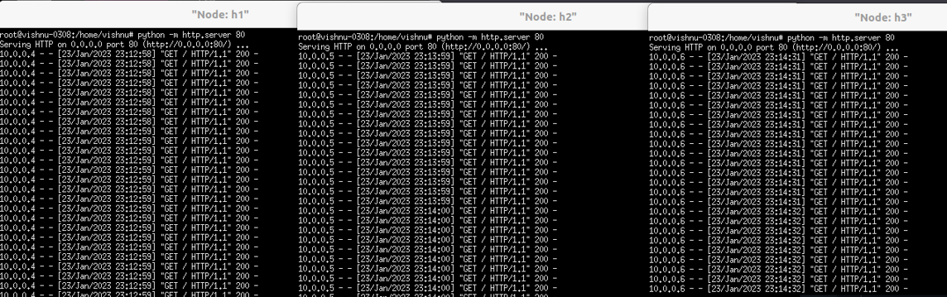

Slide 37
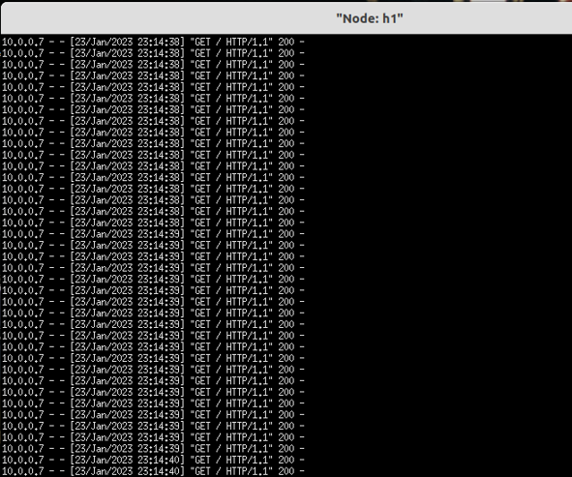

Slide 38
STATEFUL LOAD BALANCING

Slide 39
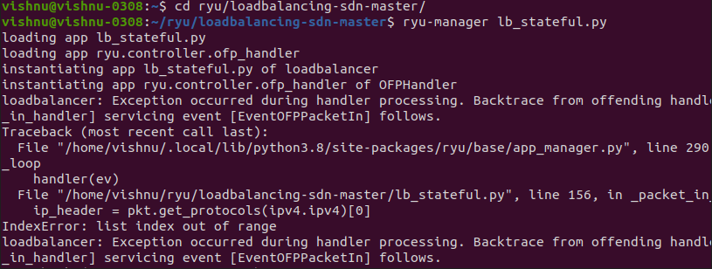
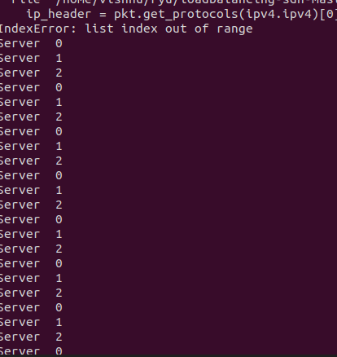

Slide 40
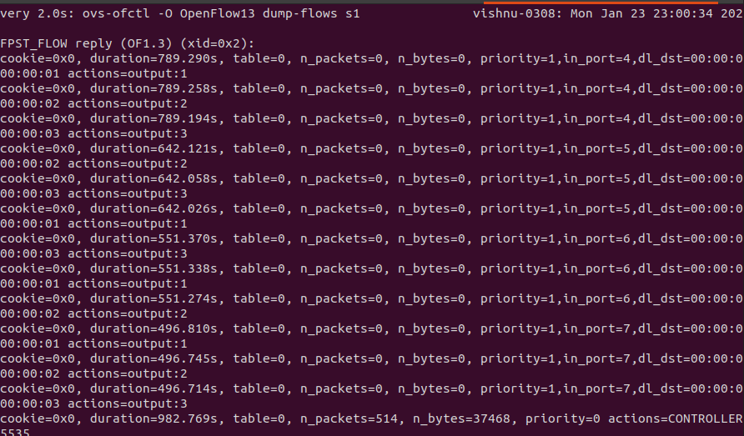
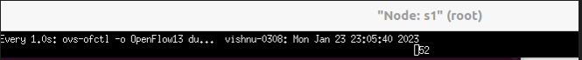

Slide 41
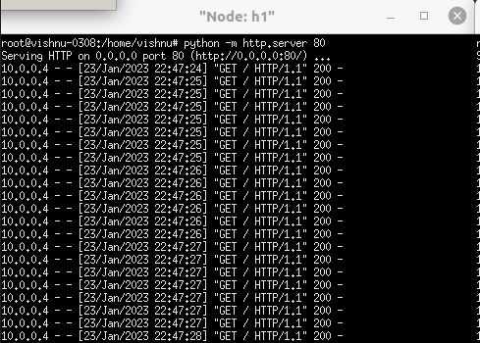
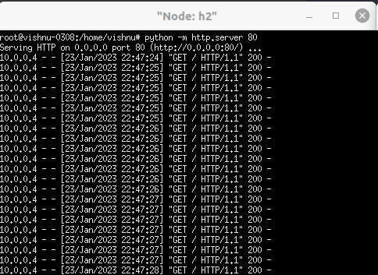

Slide 42
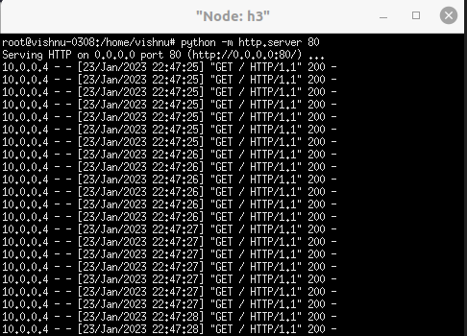

Slide 43
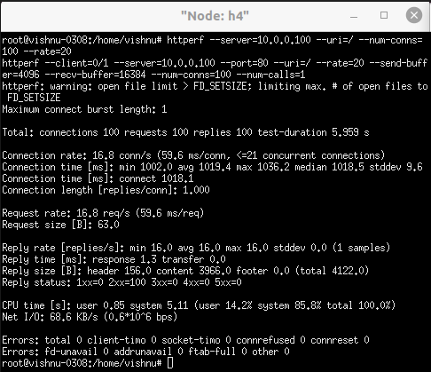
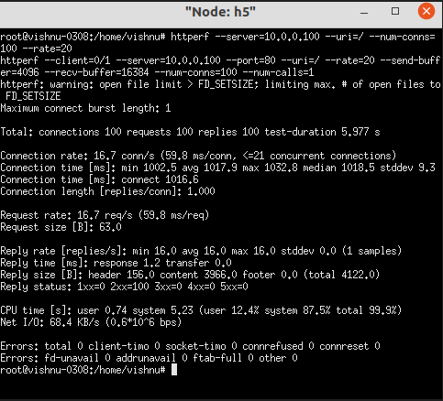

Slide 44
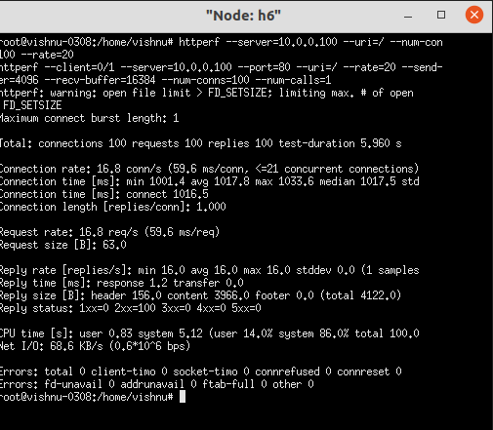
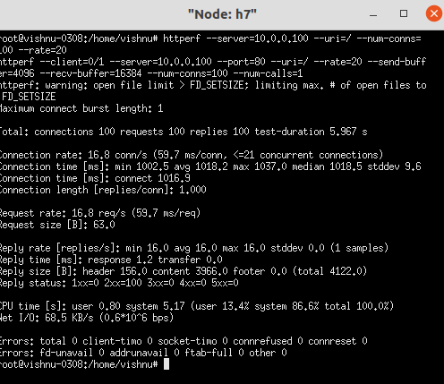

Slide 45
REFERENCES
https://wildanmsyah.wordpress.com/2018/01/21/testing-ryu-multipath-routing-with-load-balancing-on-mininet/
https://users.cs.fiu.edu/~pand/publications/13icc-yu.pdf

Slide 46
THANK YOU

